Slide 1

Enfoque de análisis predictivo y visualización de datos para el proceso de toma decisiones en estrategias de marketing: un caso de estudio
Source: Disney Plus
María Alejandra Millán Hernández
«Proyecto Final BIT»

Slide 2
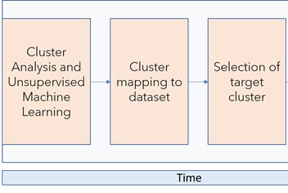
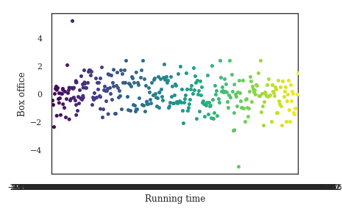
1) The workflow of the proposed method
2) Exploratory Data Analysis
Fig. 1.
Fig. 2.

Slide 3
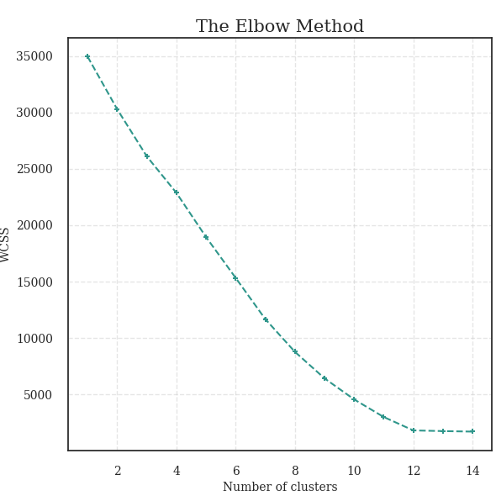
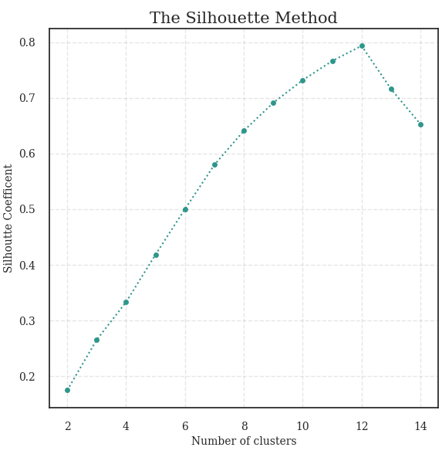
. The maximum Average Silhouette Width it is presented for K=12 clusters
.
Fig. 3. Elbow method and average silhouette for selection of cluster number

Slide 4
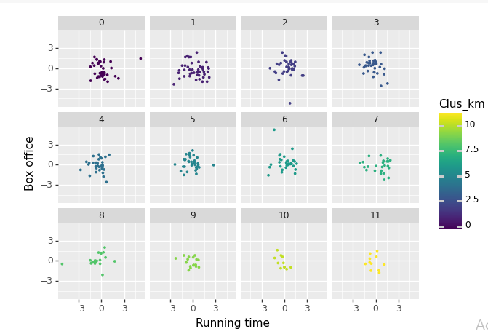
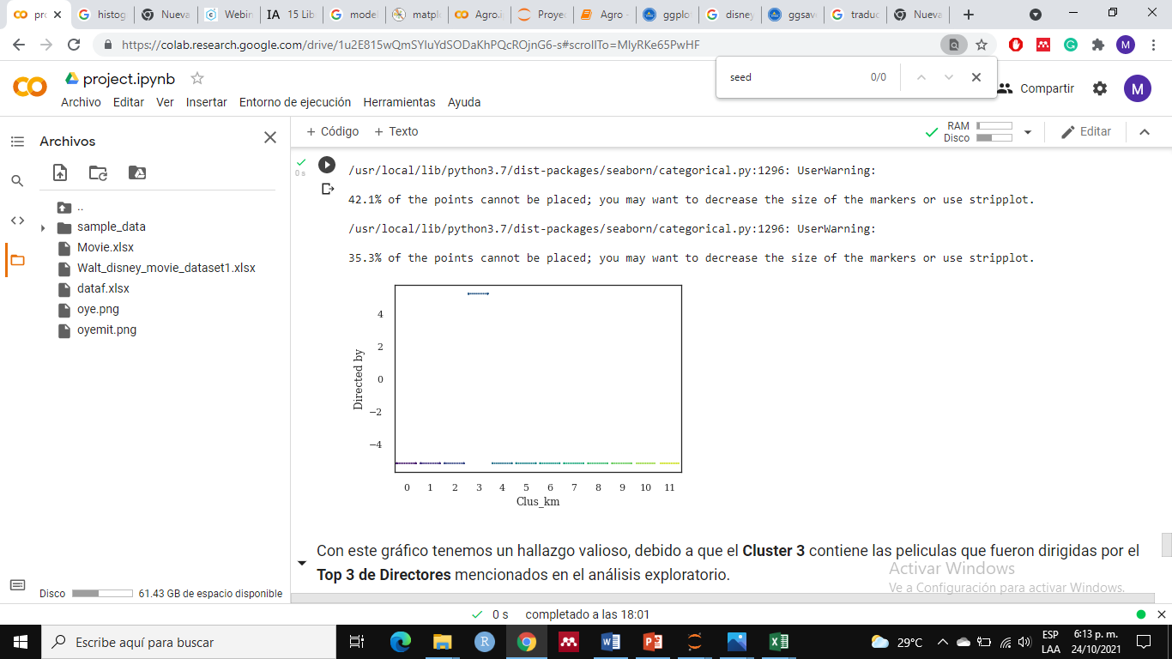
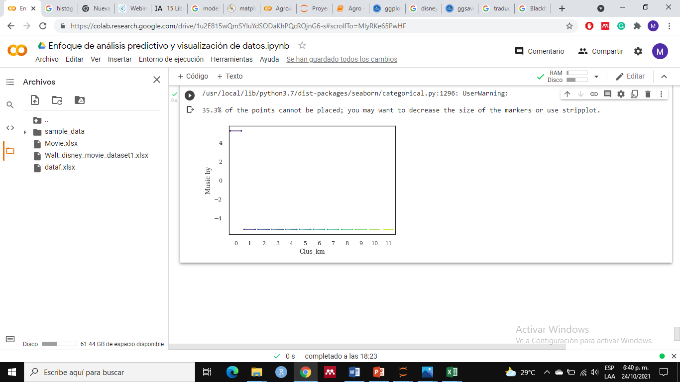
The following variables allow us to visualize the groups
.
Fig. 4. Films Clusters
Fig. 5. Clusters 0 and 3 identified as good for the strategy

Slide 5
Films by the chosen clusters considering features of each one
Clúster | Title
0 | Blackbeard's Ghost
0 | The Strongest Man in the World
3 | The Love Bug
3 | The Island at the Top of the World
Fig. 6. Example of films by clusters

